Slide 1
Getting Started with Microservices and Kubernetes: Overview

Slide 2
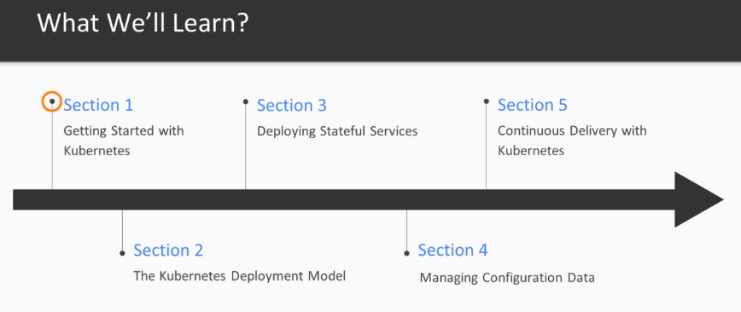
Notes:
We're going to start with section one where you're going to get acquainted with the most impodant
core concept of kubernetes.
We will then quickly put these into action in section two in which you'll learn how to deploy services
on kubernetes and how to connect them into complex service typologies.
After that we're going to shift our attention from statelets Micro's services to stage full services
like for example databases in section 3 in Section 4 you're going to learn how to securely manage configuration
data for your applications and Section Five is all about automation by continuous integration and delivery.

Slide 3
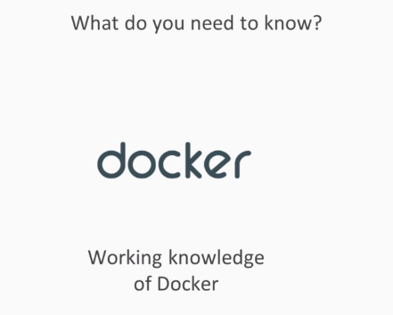
Prerequisites
Notes:
I'm going to assume that you already start with a working knowledge of docker.
You don't need to know all the details but I will assume that you know what a container is and how you
built and start your own container image.

Slide 4
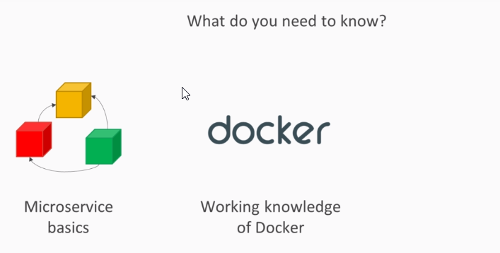
Prerequisites
Notes:
Secondly I will also assume that you have already heard of the micro service architectural paradigm
before.

Slide 5
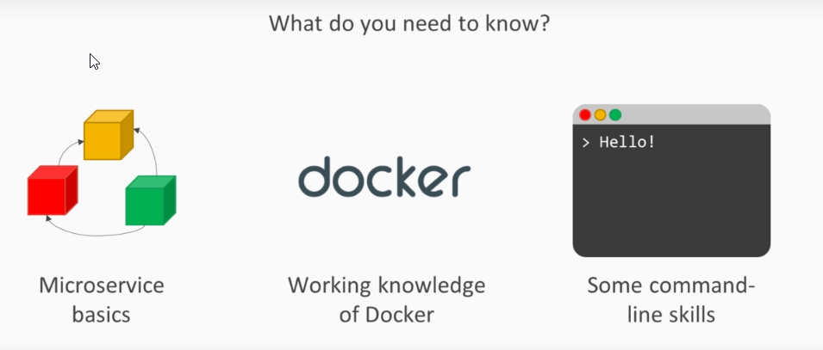
Prerequisites
Notes:
And lastly in this cause we will be using the command line quite a lot.
So I'm also going to assume that you know how to work on a Unix or Windows Shell besides knowledge.

Slide 6
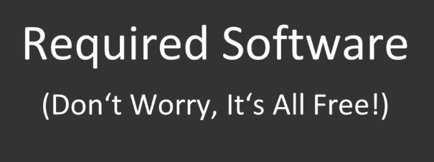
Notes:
There's also some software that you're going to need for this cause.

Slide 7
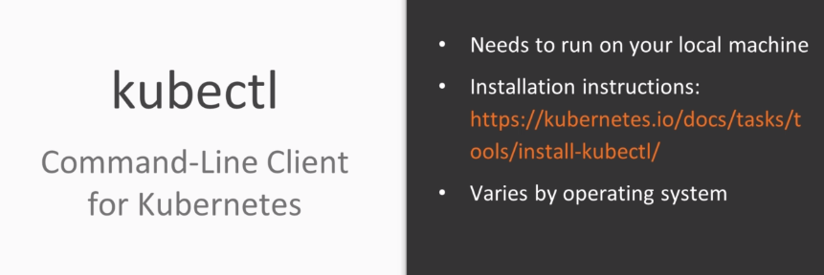
Notes:
First there is kubectl or CUPE control group control is the command line client for using kube at ease
which needs to run on your local machine for installation instructions specific to your operating system.
Have a look at the installation instructions linked on the slide in order to walk with Kevin that is
obviously going to need a working kubernetes is set up.

Slide 8
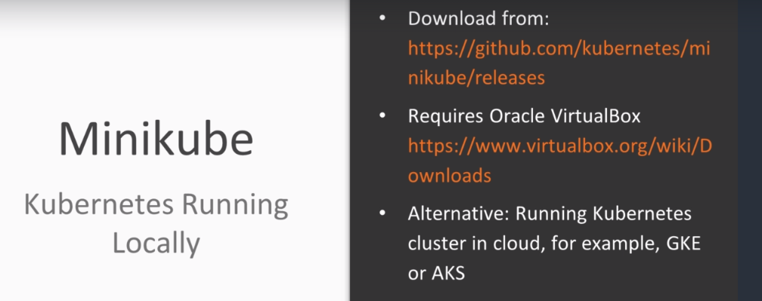
Notes:
The easiest way to get started is using Mini-Cooper which sets up a single node Cuban that is cluster
on your local machine.
To use the cube you will also need a local virtual box installation.
We will cover the local installation of kubernetes with Mini-Cooper in detail in the next section.
Alternatively you can use an existing kubernetes cluster for example at one of the major cloud providers
like the Google binaries and bring all the container service.

Slide 9
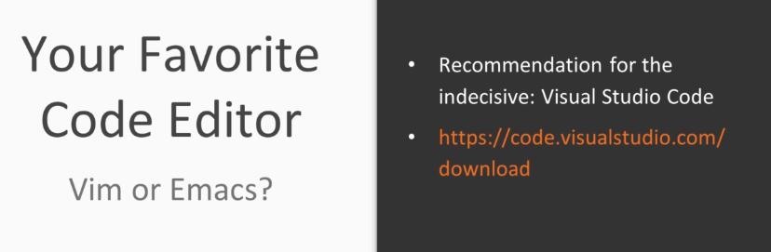
Notes:
Lastly you will be needing some kind of code editor.
Most people have their own one true code editor that they love about all.
So I'm not going to make any recommendations here except maybe be as code for the indecisive among you.

Slide 10
Setting up with Minikube
Notes:
Getting started with kubernetes in this section you will learn how to set up a local development environment
for kubernetes with mini cube mini cube allows you to set up a local single node kubernetes is environment
on your own.

Slide 11
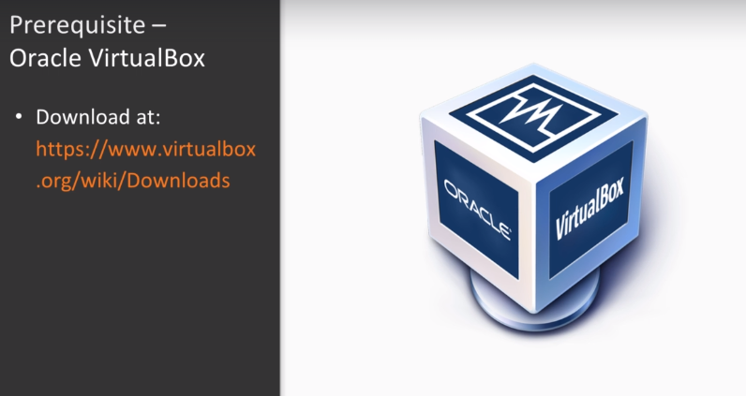
Notes:
In order to use minikube, you will need to have Oracle virtual box installed on your machine if you
haven't already download and install it from this site

Slide 12
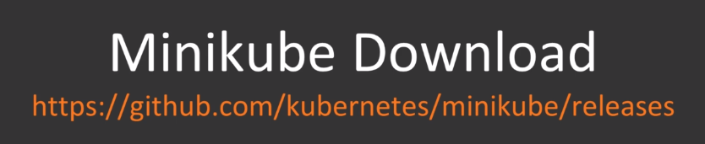
Notes:
You can download Minikube itself right from its github release page

Slide 13
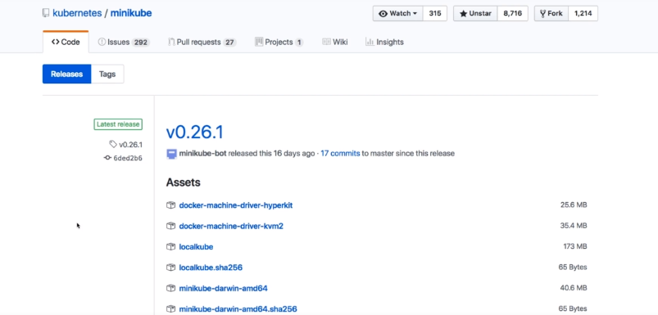
Notes:
The most recent version of Minicube is 0.26, but I have encountered some issues with this version

Slide 14
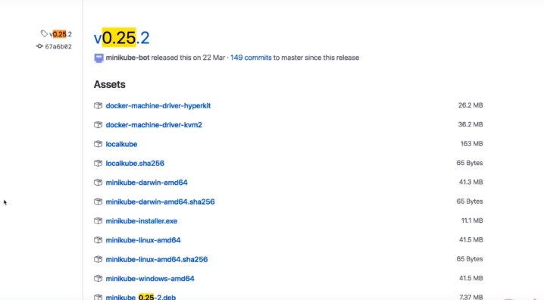
Notes:
Which is why I have chosen to use mini cube 0.25 for this class to make sure to pick the correct build for the
operating system.

Slide 15
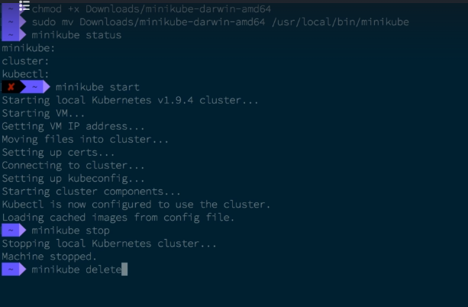
Notes:
If you are on Linux or record as make sure to make the downloaded file executable
for easier usage you can then move it to the user's local bin directory.
With Minicube installed you can use the Minicube status command to check the status of your local
cluster to start your local cluster.
Simply type Minicube stuffed into your terminal.
This will download a virtual box image for you in that environment and may take a while.
Right now the cluster is up and running and you can use it with the cube CDL command line to to stop
the cluster again.
You can use the minicube stop command if you stop the cluster.
No data will be lost.
You can simply started again with minicubes start and pick up just where you left off to completely
reset the cluster.
You can use the Minicube delete command but please don't do that now because we're still going to
need that local cluster.

Slide 16
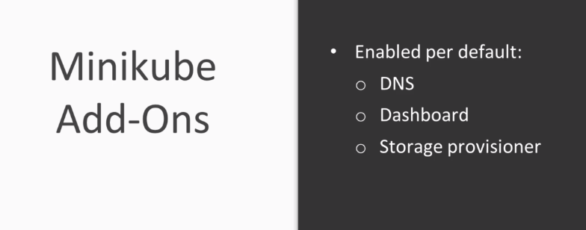
Notes:
After having started a miniature cluster we can have a look at the optional add ons that minicube ships
with by default minicube already runs the cube DNS service the dashboard and the storage provisioning.
We will cover in the later sections what these components actually do.

Slide 17
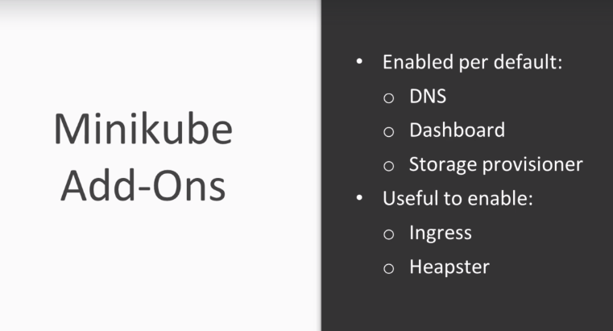
Notes:
Not enabled by default the Ingres and heapster Add-Ons.
The first one of these is responsible for handling incoming HTTP traffic and the second one is responsible
for collecting pod resource utilization metrics. Both of these features will prove to be useful in the following sections.
So let's enable the to enable a add on.

Slide 18
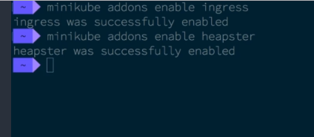
Notes:
You can use the minute you add ons enable command.
Let's use this command to enable both the Ingres and hipster ons with a local cluster up and running.
You can now test the Cuban That is called concept for yourself.

Slide 19
Deploying a Microservice

Slide 20
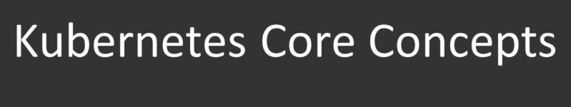
Notes:
Let's have a look at a few core concepts of kubernetes.

Slide 21
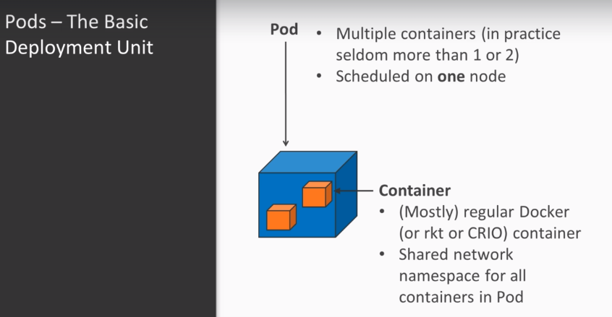
Notes:
The basic deployment unit in a kubernetes is cluster is the pod each pod may consist of multiple containers
although in practice there are seldom more than one or two containers pod all containers with in one
pod are scheduled on the same node in your cluster.
The containers are mostly regular application containers.
Typically Cuban That is well used.

Slide 22
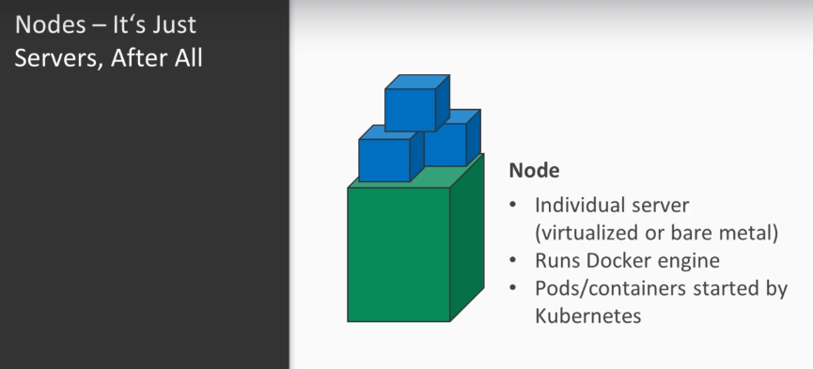
Notes:
Dr S contain a runtime but it also suppods rocket and QRIO containers Jacobin that is clustered consists
of one or more nodes.
Each node is its own server.
Either virtualize or physical and is capable of running containers.

Slide 23
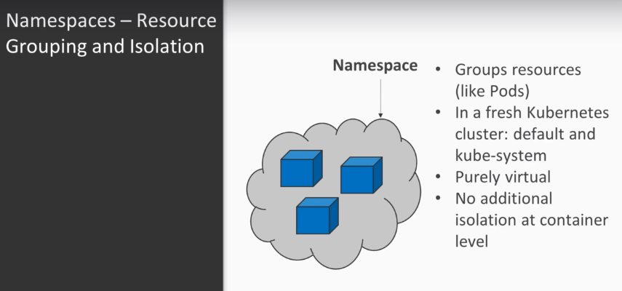
Notes:
When you create a new pod Kubernetes will automatically schedule the containers of this pod on any
node that has spare capacity resources and kube that is are organized in namespace.
A namespace is a virtual grouping of arbitrary resources like for example Pod's in a freshly installed
cluster.
You will have to already existing namespace.
First of all the queue system namespace which contains kube-system components by default.
You should not modify any resources in the cube System namespace.
The second one is the default namespace which is initially empty and just a regular namespace.

Slide 24
Defining a Pod
Notes:
Let's start by defining a simple pod.

Slide 25
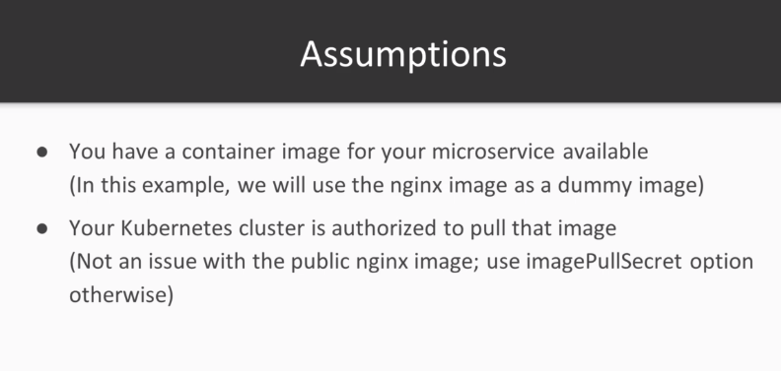
Notes:
For this we will assume that you already have a container image for the service that you want to deploy.
For the purpose of this example we will use the publicly available nginx image as a dummy image
that stands in for your own Microcircuits of course your criminalists cluster should be authorized to
pull that image.
That being said let's get started.

Slide 26
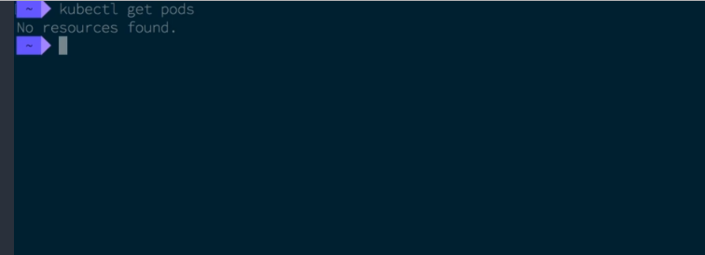
Notes:
You can use the kubectl get command to interact with your kubernetes is custom.
For example use kubectl.
Get pods to list all the already existing pods.
Since we have just set up the cluster.
Of course there are no pods yet.

Slide 27
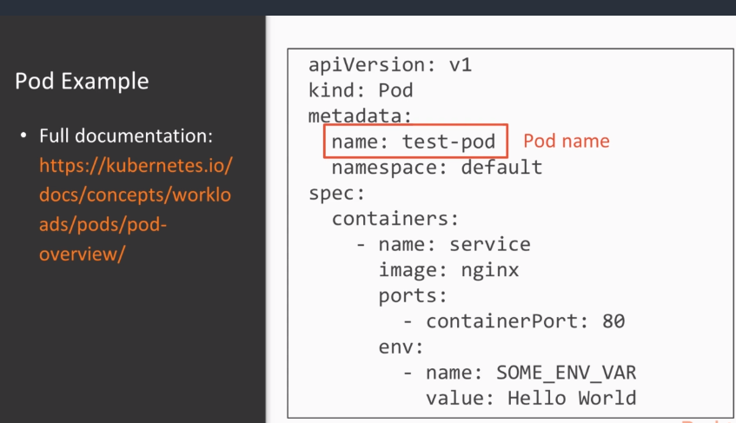
Notes:
So let's go change that continer resources are defined in YAML files.
This is an example YAML file that defines a pod with one single containing as you can see

Slide 28
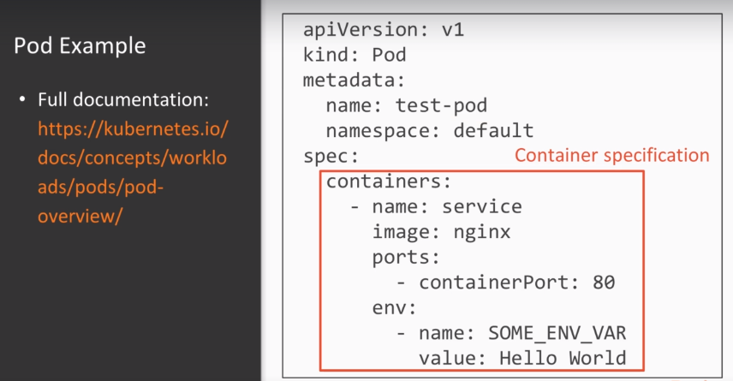
Notes:
the pod has a name lefse in the default namespace and consists of one container using nginx.
Image knows how you can pass environment variables into the container.

Slide 29
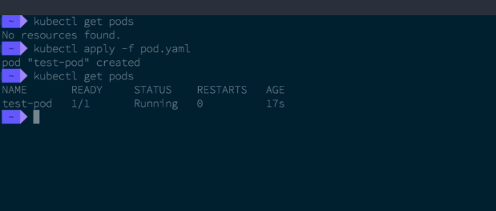
Notes:
To create a resource call kubectl apply
Def f with the file and switchgear resource is defined.
You can use the same command later again to update the pod if you change the definition.
Let's run kubectl I'll get pod again and you will now be able to see the newly created pod.

Slide 30
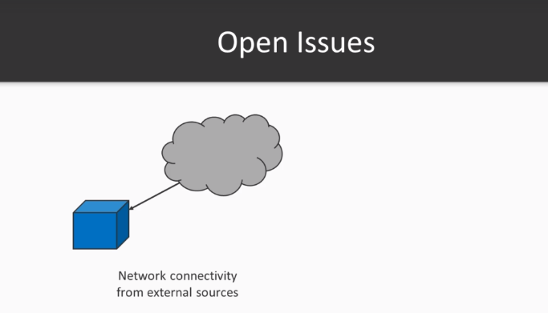
Notes:
While we have now successfully started in you containing no acuminate is cluster there are still a few
open issues.
Most impodant of all there was no way yet to connect to the service running in the freshly created
pod.

Slide 31
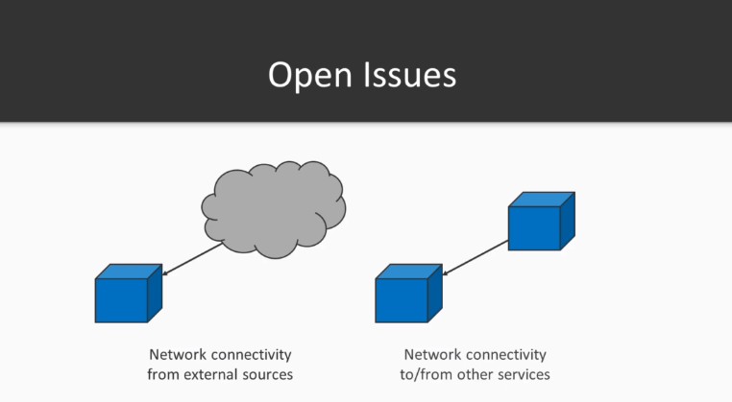
Notes:
This goes both for network connections from outside your kubernetes cluster and as well for connections
made by other services running in the same cluster.

Slide 32
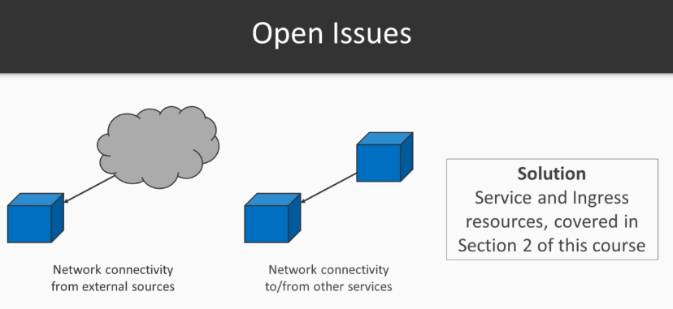
Notes:
We will cover a network connectivity for pods using services and Ingress resources in detail in section
2 of this course. This was just a super quick teaser on how easy it is to start pods and containers with kubernetes over
the following sections.
We will explore this concept in detail and you will learn how to deploy more complex service typologies
and how to connect them with one another in the next section.

Slide 33
Service Resiliency and Scalability

Slide 34
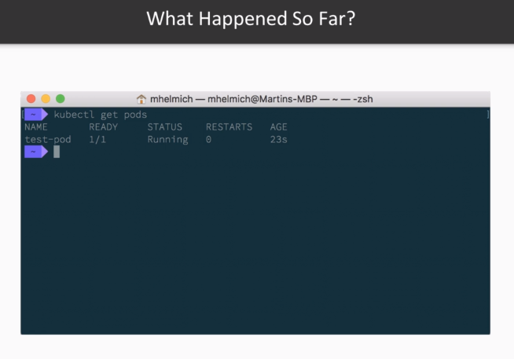
Notes:
In the previous sections we have already used kubernetes to create a pod which runs the nginx container

Slide 35
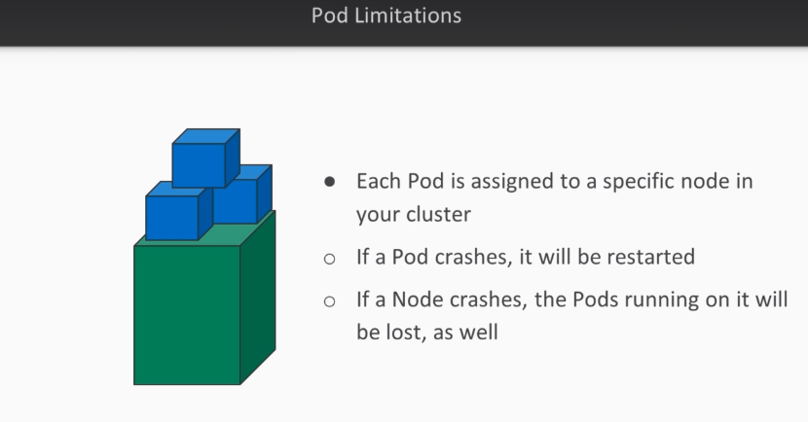
Notes:
image each pod managed by kubernetes is assigned to one specific node in your cluster.
If that pod crashes for example due to an application error or an out of memory condition it will automatically
be restarted.

Slide 36
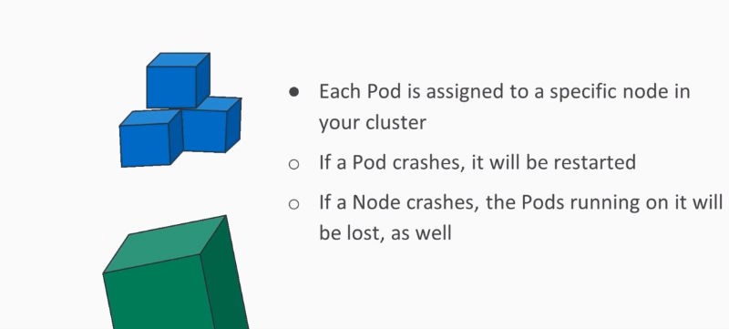
Notes:
However if an entire node fails all pods running on that node will be lost as well.

Slide 37
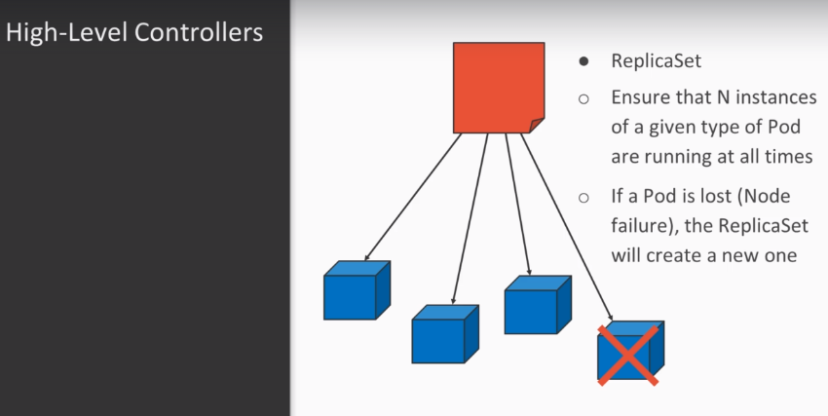
Notes:
This is obviously not desirable given that we want to provide service resiliency and scalability
Our high level controllers like for example the replica set a replica set is a Cuban resource that makes
sure that a given number of instances of a pod are running at any given time.
If one of the pods managed by a replica set is lost for example due to a node failure in the replica
that will automatically create a new pod to replace the failed one.

Slide 38
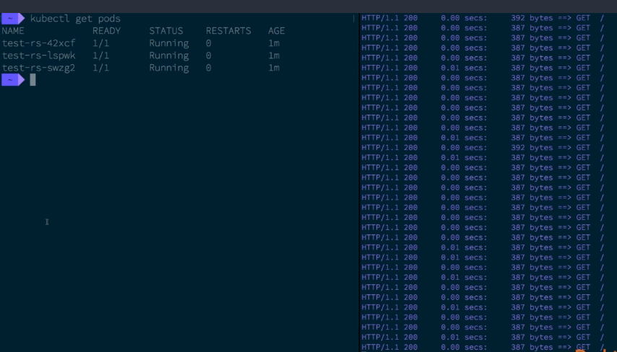
Notes:
In this example we have set up a replica set that managed was 3 nginx pods on the right hand.
We have a switch benchmark that is constantly hitting that replica set with HTTP requests
are load balanced evenly over all three pods of the replica set.
You will learn how to set up typologies like this by yourself in the upcoming section of this course.

Slide 39
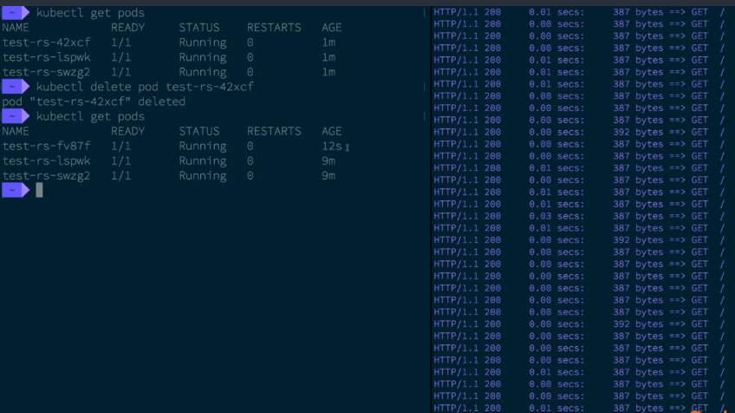
Notes:
Now let's try to see what happens when we meddle with these pods we will start by deleting one of these
plots that way we can basically simulate inode failure affecting this one pod the expected result is
that the overall service should still remain available and we should not see any HDD Pietro's.
As you can see there are no failed requests after having removed one of the replica sets pods.
In fact you will notice that the replica set has already created a new instance to make up for the replica
that we have just deleted in conclusion.

Slide 40
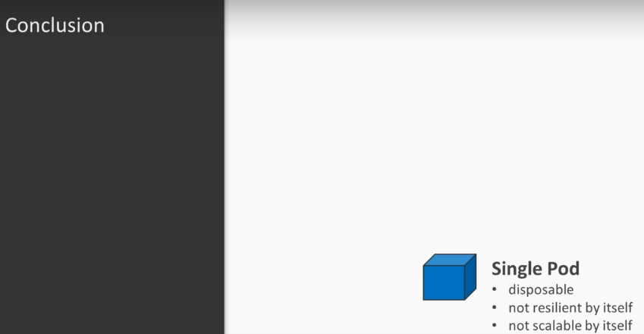
Notes:
You should keep in mind that a single pod is considered as disposable in itself.
It is neither resilient to failure nor scalable to introduce resiliency and scalability.

Slide 41
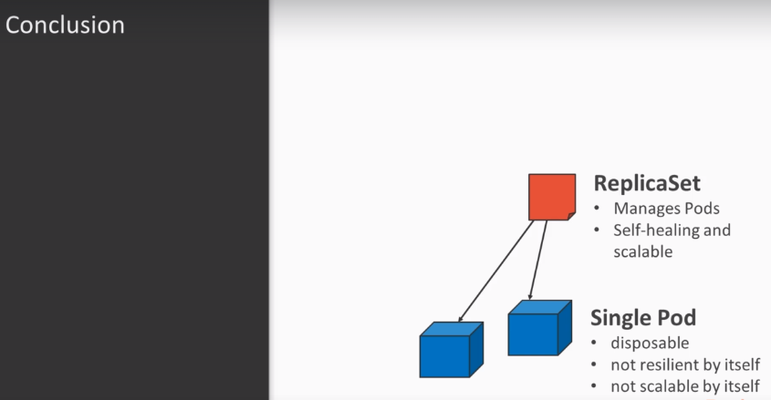
Notes:
You can add a higher level controller like replica set which manages a given number of instances of
a certain pod a replica that is resilient to failure and can be scaled another high level controller

Slide 42
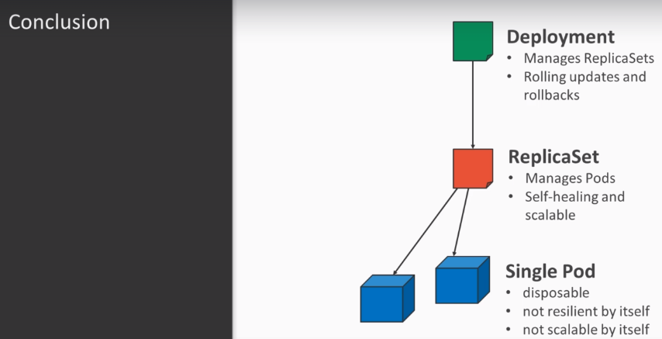
Notes:
is the deployment deployment management replica sets and can be used to provide rolling updates and
rollbacks for different versions of an application.
You will learn about replica sets and deployments in section 2 of this course.
Then there is also the stateful set a stateful set works similar to a replica set but in addition it
also provides pods with a stable network identity and start up all of this makes it useful for cluster
stateful applications like for example databases.
You will learn more about stateful sets in sections 3 of course.

Slide 43
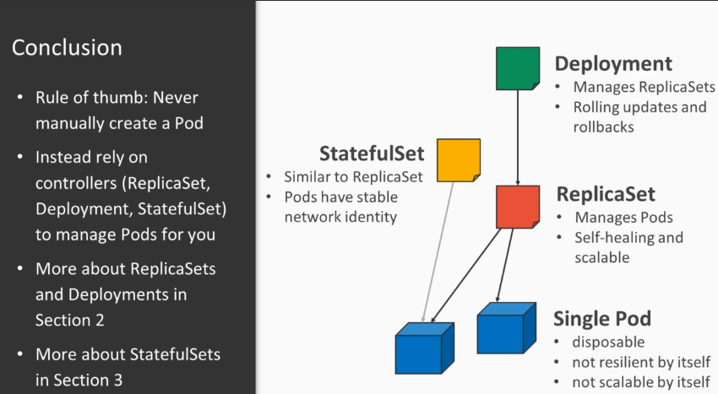
Notes:
So to sum things up level manually created pod but steps create high level controllers like replica
sets deployments or stateful sets and have these managed your pods for you.
In the next section you will be able to put your new knowledge and kube at ease.
High level controllers to the test will start by working with replica sets and then walk away from there.

Slide 44
The Kubernetes Deployment Model
Notes:
In Section 2 of this course of the Kubernetes deployment model you will learn
how to create scalable and resilient deployments using replica assets.

Slide 45
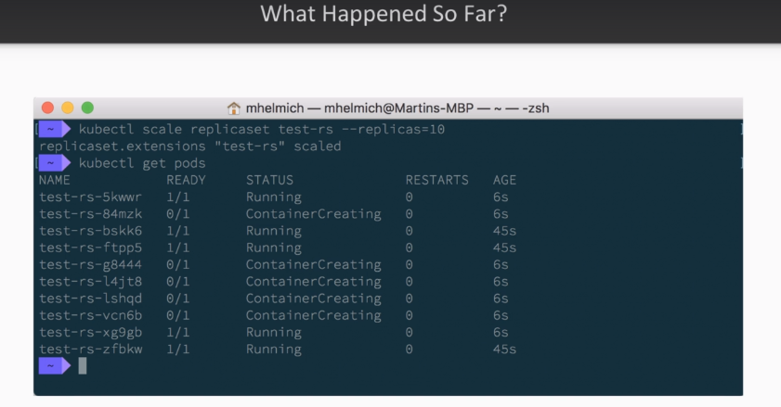
Notes:
You have already learned that kubernetes are for high level controllers like for example the replica
set to implement the service resiliency and scalability.
What you have already learned what a replica set is good for in general I haven't shown you yet how
to actually create one that will change in this section.

Slide 46
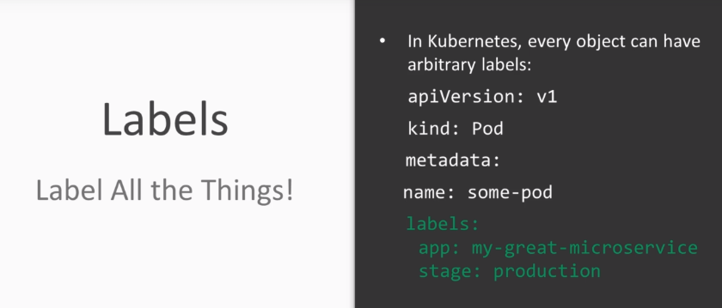
Notes:
But before diving into replica sets let's have a look at another core concept of kubernetes labeling
each and every object in a kubernetes cluster can have arbitrary labels.
For example when defining a pod you can specify labels in the pods metadata section.
You can then use these labels to query and filter objects.
For example you can use the dash -- switch of the kubernetes or get command to only list objects with
a certain labe. l that value understanding how labels work is impodant.

Slide 47
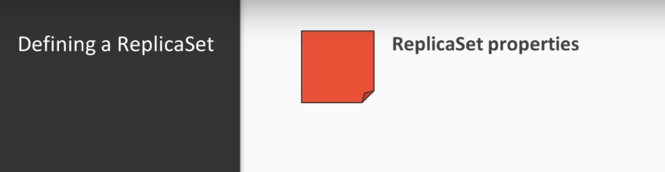
Notes:
Because we are going to be needing them when defining a replica set.
Just as plot's replica sets are defined in YAML files.
Let's cover the most important aspects of a replica sets definition.

Slide 48
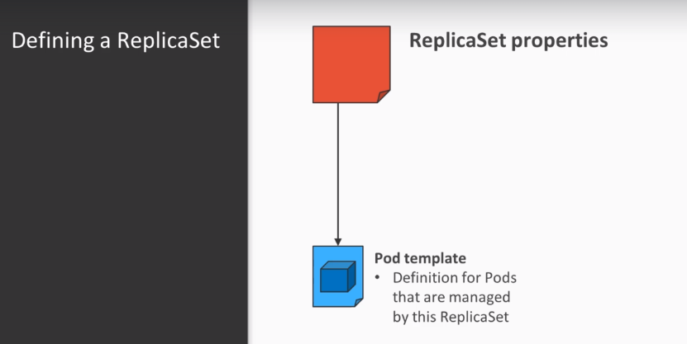
Notes:
First of all the pod template is used as a definition for pods that are created and managed by the
replica set.

Slide 49
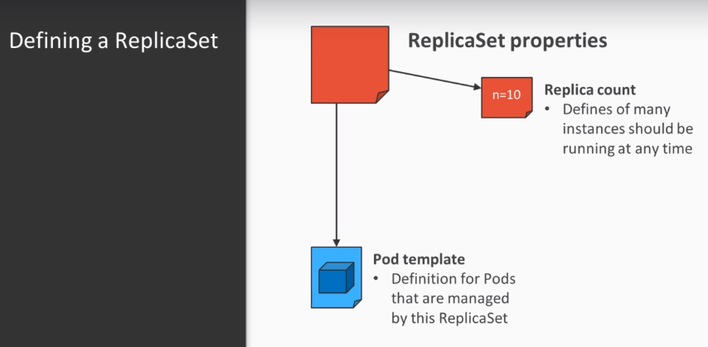
Notes:
The replica count defines how many pods created by the given template should be running at any given
time.

Slide 50
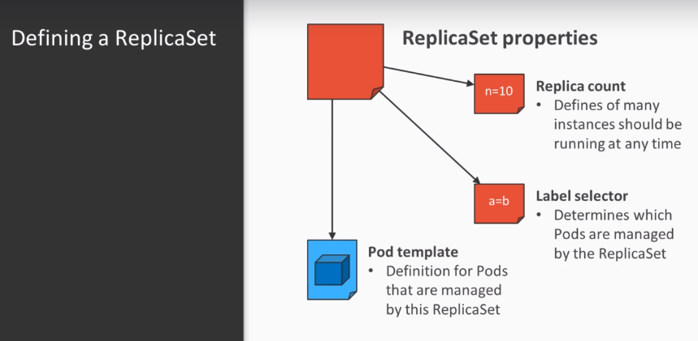
Notes:
And finally the label selector determines which pods are actually considered as being managed by the
replica set.

Slide 51
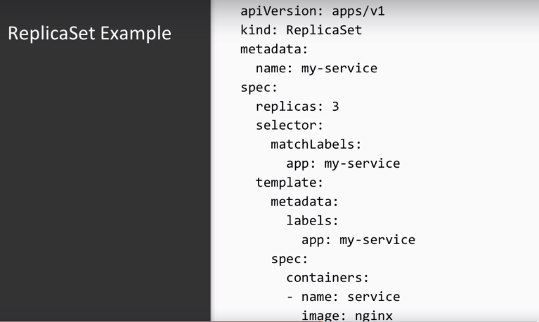
Notes:
Let's have a look at how the replica set is actually defined.

Slide 52
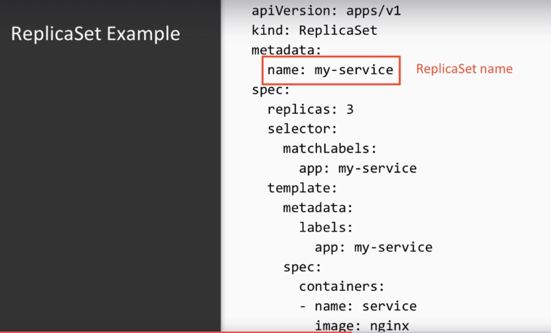
Notes:
First of all as any object the replica set needs a name and the matter they just.
You could also attach any arbitrary labels to the replica set itself.

Slide 53
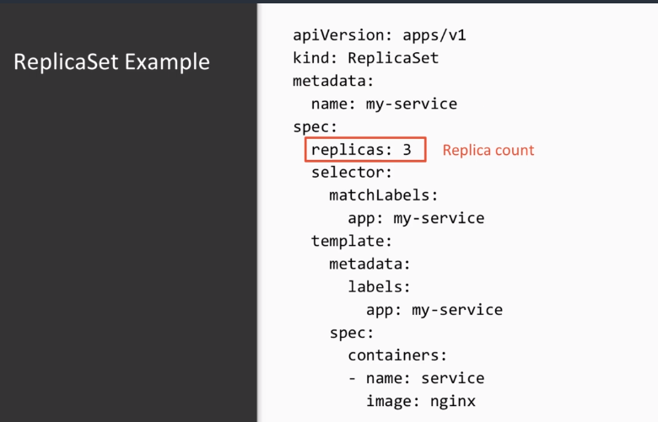
Notes:
Then you have the replica count which would be fairly self-explanatory

Slide 54
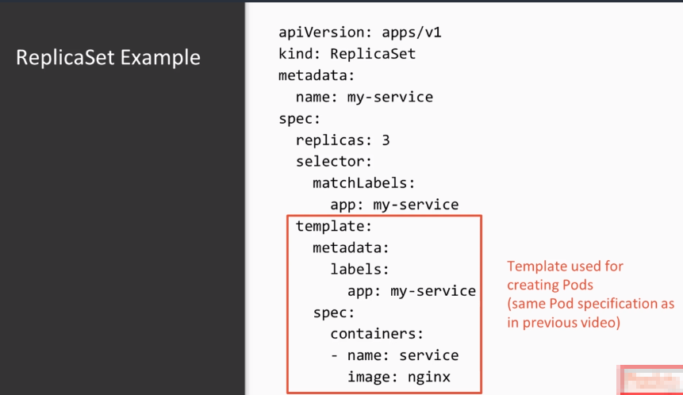
Notes:
and then you have the template section for template contains a pod definition that will be used by the replica set to create new pods. The pods template itself is quite similar to the definitions that we previously worked with

Slide 55
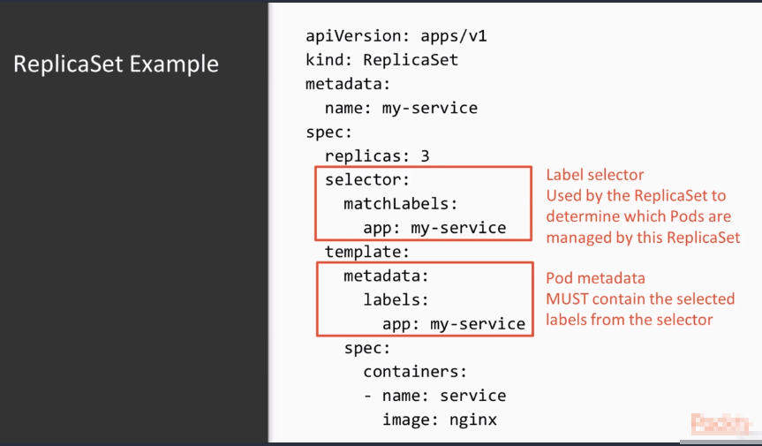
Notes:
And finally the label selector contains a match labels property that will be used to determine which
pod is going to be managed by the replica set these same labels need to be contained in the pod.

Slide 56
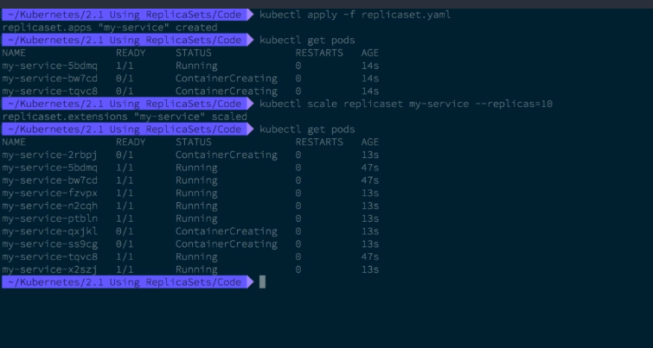
Notes:
Templates matter data just as creating a pod you can create a replica set using the cube CDL apply command
the HTML file and this case contains the replica set definition shown earlier.
Terminate existing ones to make sure that the actual number of running pods always matches the specified
replica and you may have noticed that we still haven't talked about how you can make the plot application
accessible via a netbook with some knowledge on how labels and replica sets work.
We can now cover this topic in the next section in which we will have a detailed look at services.

Slide 57
Connecting Services
Notes:
In this section, you'll learn how to provide network connectivity to your Kube that is pod's using services.

Slide 58

Notes:
In the previous section, you have learned how to create a replica set and how to scale it. In the previous section you have learned how to create a replica set and how to scale it. And this section we will build on that and create a service that offers a stable network connectivity
for other pods or external users that want to connect to your replica sets pods first let's have a
look at how pods are networked.

Slide 59

Notes:
In general each pod in your kubernetes cluster has its own IP address.
Usually that IP address is usable only within the cluster.
This would allow one podal to open and a connection to another but given that it knows that IP address.
But you cannot use a pod IP address to connect to that pod from outside of the cluster say from the
internet.
For example also pods are usually short lived pods managed by replica sets are often created and deleted
when the replica is Kales and each pod will get a new IP address.
Furthermore kube at least does not provide DNS for resolving pod IP addresses.
That's why our services come into play.

Slide 60

Notes:
A service is a special kind of kube that is resource that selects a given set of pods by label (remember the
label selector from the previous section) and provides a stable IP address and DNS name for that group
of pods.
If the service selects multiple pods for example all pods managed by a replica set it will load Pollan's
incoming data connections among all of these pods.
When the replica set is scaled up or down and adds are removed pods the service will automatically
add or remove these pods IP addresses from its routing table.

Slide 61

Notes:
There are different types of services.
First there is the cluster IP service type. a cluster IP service provides an IP address that is routed
within the cluster and can be used by other pods in the cluster to connect to the pods selected by
that service cluster IP service will also provide a DNS name that can be used from within the cluster

Slide 62

Notes:
and which will also to the service IP the node pod service type work similar. But in addition it opens a new CPO or you repod on each node in your cluster that will forward traffic
to your service if your nodes have publicly ratable IP addresses.
That alone is sufficient to make a service reachable from the public internet or other external networks.

Slide 63

Notes:
Lastly the load balancing service type works.
Again similar to the node port-service But if you're using it within a public cloud environment it will
automatically use that cloud providers API to provision an external load for them so that accepts traffic
and forwards to your pods.
Often the load balance service type is the best choice to make a service accessible from the Internet.

Slide 64

Notes:
Let's have a look at how a service actually defined this service definition will create a service that
will select all pods created by the replica sets that we have created in the previous section of the
section just like pods and replica sets the service will need a name

Slide 65

Notes:
the name will also later be the
DNS name that can be used by other services to connect to the service.

Slide 66

Notes:
Then we have the service type.
Aside from cluster IP as shown in this example Velvet's values would be nodePort and load balancing
the pod selector is used to match pods by the labels.

Slide 67

Notes:
The service will select all the pods that have the given label values and then forward traffic to those
pods with round robin load balancing.

Slide 68

Notes:
Lastly we have the pod Authority which defines which TCP are UDP pods should be forwarded by the service
just as with other kubernetes it's resources you can use the kubernetes or get command to list existing
services and kubernetes or apply effort to create a respectively update to them
after having created a service kubernetes and get services.

Slide 69

Notes:
just as with other kubernetes it's resources you can use the kubernetes or get command to list existing
services and kubernetes or apply effort to create a respectively update to them
after having created a service kubernetes and get services.
Display the cluster IP that was assigned to that service to test if we can connect to the service.
You can start an additional pod using the kubectl run command sets the def I am staffed reflex to immediately
attach your terminal to that container and the daftest are Amphlett to terminate suppod.
Once you disconnect your terminal lets start a simple opined Linux container in which we can then install
kernel to test the HGP connection to our replicas that with the service that we have just reached its

Slide 70

Notes:
we can always use CURL to execute and HTP request to our new service from was in a pod in the same
namespace.
You can simply use the service name as DNS name.
The fully qualified domain name of that service would usually be my service or in general the service
name dot default dot SPC dot cluster dot local to create a local service instead of a regular cluster
IP service.

Slide 71

Notes:
Simply replace the service type with the value load local and provider to that your cluster is running
in a cloud environment suppoded by kubernetes like for example the Google compute nginx A.W. as ever
are open stack that will automatically create a virtual load balancer that is accessible from the internet
and forwards all traffic to this specific service services are the easiest way to make applications
accessible via a network.
However having a separate load balancer for each public service is often not the best way to do for
services that expose HTP interfaces.
There is an alternative solution.

Slide 72
HTTP Connectivity with Ingress
Notes:
In this section, you will learn how to provide HTP connectivity to your applications

Slide 73

Notes:
Using Ingress resources in the previous sections, you have already work with services which allow you to
both connect applications in your cluster with each other as well as make them accessible from outside
your cluster.

Slide 74

Notes:
However services have some limitations.
For example they forward traffic only on the TCP/UDP layer and that means that a service cannot use
features of any specific application protocol like for example HTTP.

Slide 75

Notes:
This is where ingress resources come into play ingress resources define specifically how incoming HTTP
requests should be forwarded to your podt's ingress resources suppod a wide range of HTTP protocols
features like for example path and host based routing caching authentication deal as termination and
many more.

Slide 76

Notes:
This is how the typical Ingress definition looks like.
a pod from the usual metadata on an Ingress definition consists of rules.

Slide 77

Notes:
Each rule matches one HTTP hostname and can have multiple Suppe rules that match individual paths each
rule describes that incoming HTTP ingress matching the specified host and path should be forwarded to
a specific service.
These services need to be defined beforehand as you have learned in the previous with you these services
can be regular cluster IP services and they do not need to be publicly accessible.

Slide 78

Notes:
Ingres definitions are purely virtual.
They require an ingress controller that is an actual piece of software that needs to be running within
your own kubernetes cluster.
The Ingres controller accept its HTTP connections and can then start HTTP requests and routes them where they should go
as defined in the actual ingress definitions.
You can deploy an Ingress controller in your kubernetes cluster using regular deployment and service
definitions.

Slide 79

Notes:
For example you can have a look at the nginx Ingress controller for more information on that.

Slide 80

Notes:
Also some cloud providers like for example the Google container nginx also provide their own ready
to use ingress controllers for you so that you don't have to deploy your own.

Slide 81

Notes:
You can list create and manage ingress resources using the usual kubectl commands.
Let's use the kubectl apply command to create the Ingress response shown earlier.
When using Minnock you you typically already have a running Ingres controller that automatically processes
these rules.
You can check with the mini cube add on the list command if your Inglese controller should be disabled
in the output of many cube at least you could enable it with a command mini cube add ons enable ingress
you can determine the IP address of many cubes Ingres controller using the command mini cube IP for
testing purposes.
You can add that Ingres controls IP address to your ADC hosts file and then open that hostname in your
browser.

Slide 82

Notes:
In this case the host name your app thought example is the same hostname that we've used in our Ingres
rules in the definition of that we have just created.

Slide 83

Notes:
So let's go and open that's domain in our browser after we've added it to the hosts file.

Slide 84

Notes:
As you can see the HDD request made by our browser is forwarded to the actual pods running that are
managed by all replicas set.
In this case as we are just using the empty nginx X container image we just see an error page because
that image does not serve any actual content.

Slide 85

Notes:
a pod from firewalling edge to Depue request Ingres resources and controllers offer additional features
built on HTTP for example a typical Ingres controller offers DL as of loading.
This frees your from having to manage keys and certificates within your own application pod but you'll
still have the option to have incoming traffic encrypted as it enters your cluster.

Slide 86

Notes:
Furthermore you can use rate limiting to prevent application pods from becoming overloaded with requests
also an Ingres controller might be used to add a simple authentication layer to your application you

Slide 87

Notes:
You now know the necessary tools to run an application on kubernetes to interconnect with other applications.
And how do you make it accessible from external network.

Slide 88
Managing the Application Lifecycle with Deployments
Notes:
In this section, you will learn how to update your deployed applications without
downtime using deployment objects.

Slide 89

Notes:
In one of the previous sections, you have already learned how to deploy scalable and resilient applications
with replica sets.

Slide 90

Notes:
However replica sets have some limitations when a replica set creates a new pod.
It will use the pod templates defined in its specification.

Slide 91

Notes:
However if you change that specification for example by changing the doctor image for the container
the replica set controller will not update any of the existing pods unless you manually delete them

Slide 92

Notes:
and have them recreated by the replica set controller.

Slide 93

Notes:
Deployment objects solve this problem.
Deployment managers multiple replica sets.
If the specification is modified like for example again by changing the container image the deployment
controller will create a new replica set using the new image.
Then the controller will gradually scale up the new replica set and scaled down the old replica set
as the new pods become ready This allows you to provide updates to the application that are rolled out
automatically without having to suffer any kind of downtime.

Slide 94

Notes:
This is a typical general specification from a deployment.
Luckily there is not that much new to see here.
As you may notice the deployment specification looks very very similar to that of the replica set that
we've already looked at in a previous section

Slide 95

Notes:
In the section just as with most other kubernetes resources you can list create and manage deployments
using the usual coupes DL commands.
Let's use the cube CDL apply command to create the deployment shown earlier.
As you can see just as a replica set the deployment creates the required amount of pods.
In fact the only thing the deployment controller actually does is creating a replica set that you can
also have you using the appropriate commands.
In order to show the benefit of a deployment we can change the deployments container image in the specification.

Slide 96

Notes:
For that we're going to be using the kubectl edit command that you can use to quickly edit an existing
kube that is resource.
Let's change the container image to a more recent version of that image.

Slide 97

Notes:
After updating the deployment you will notice that the deployment controller starts to shuts down the
old version of the deployment one by one and begin starting new pods.

Slide 98

Notes:
This is actually being achieved by creating a new replica set.
That is gradually scaled up while the replica set is gradually being skater's down.
In case your new deployment version introduced an error.

Slide 99

Notes:
For example because of a bug in your application you can also rollback the latest updates to your deployment
using the kubectl roll out undo command.
This will revert to changes made by the previous added scale.
The new replica set back to 0 containers and scale the old replica set back up to the original replica
Cohn's.
In this section you have learned all about the necessary tools to deploy and Update Services on kubernetes
and connect them with one another. However there is one thing that we did not cover yet and that is managing containers that need to store
data in order to work.
He will regularly encounter this issue.
For example when you want to deploy stateful containers like for example database.
For this reason you will learn how to deploy stateful persistent containers into binaries in the next
section of this course.

Slide 100
Stateful Services and Storage Drivers
Notes:
in this section of the course we are going to talk about
stateful services watch that you may ask yourself so before talking about anything else let's have a
look at what states will services.

Slide 101

Notes:
Actually our Up until now we have only worked with stateless services.
These consist of pods that do not have any kind of internal state that would need to be kept.

Slide 102

Notes:
With your knowledge up until now you could never start a pod that reads and writes data from an external
storage service like for example a database or an object store that is hosted outside of the cabin that
is cluster and that is for example provided by your cloud provider

Slide 103

Notes:
what you're going to learn in this
section is how you can stop pods that strong data which is kept persistent even across pods terminations
and Recreation.

Slide 104

Notes:
The key concept here is that of the persistent volume or persistent volume or PV forthought can be provided
as a file system to a Cuban that is pod of its lifecycle is independent of that of the pods using
it.
That means if you delete a pod using the volume the volume will still stay there even if you have deleted
the pod.
This is quite impodant as you may remember from the previous section.
pods are deleted and created quite regularly in kubernetes for example when a deployment is scaled
up or scaled down or a rolling update is triggered in any of these cases you would want the data managed
by a pod to persist even if the original pod does not dependent on the chosen search nginx.
We'll get to that in a bit.
PV can be used by multiple pods at once offering a flat file system to multiple pods.

Slide 105

Notes:
You may have noticed right now that some features depend on the chosen search nginx.
It's important to node that suppod for persistent volumes and kube that is is designed to be pluggable
and does not depend on any kind of specific search nginx.
In practice this means that you will have to pick a storage nginx that fits your own requirements and
your own environment.

Slide 106

Notes:
Well in general there are two kinds of volume types that you'll need to pick from Network block devices
and network file systems and network block device is very similar to a regular block device like for
example a hard disk it typically is of a fixed size and can be used by one pod but not more than one
pod at a time.

Slide 107

Notes:
and network file systems and network block device is very similar to a regular block device like for

Slide 108

Notes:
and network file systems and network block device is very similar to a regular block device like for
example a hard disk it typically is of a fixed size and can be used by one pod but not more than one
pod at a time. If you are running in a cloud environment kube that will integrate with that provider's API in order
to offer block device suppod for you without too much configuration.
Among the suppoded providers you'll find a GCE agile and open stack.

Slide 109

Notes:
On a technical level in practice they are often slow other network block devices but can be used by
multiple pods at the same time.
Network file systems offered by your cloud provider include for example the AWOS elastic file system
and Raphael's self-hosted example includes software like Zeff as and cluster of S and also the good
old NF as on a final node

Slide 110

Notes:
old NF as on a final node
Please node that setting up solutions like self are other self-hosted software will be considered out
of scope for this course.
If you are interested in learning more about Ceph have a look at the book link in the slide.
Also please node that you are not limited to using just one storage nginx in your cluster.
You can mix different nginxs as you see fit for a full list of suppoded storage ends and you can also
have a look at the official kube that is documentation with this background knowledge on how storage
works in general and kubernetes in the next one here.
We will now have a look at how to actually work with persistent volumes in Kubernetes.

Slide 111
Working with Persistent Volumes
Notes:
In this section you will learn how to create and use persistent volumes. In the previous section,.
You learned what a persistent volume of PV and chart does in general to actually use a
persistent volume.

Slide 112

Notes:
You have already learned what a persistent volume of PV and chart does in general to actually use a
persistent volume.

Slide 113

Notes:
In kubernetes it first needs to be contained.
The persistent volume itself describes a specific block device of file system that is available in your
network.The persistent volume claim then claims or persistent volume for use in one or more pods.

Slide 114

Notes:
The reason that kube that is makes the distinction between volumes and claims is that often these two
objects are created by different persons.

Slide 115

Notes:
Often the application operator meaning the person that deploys an application on kubernetes is not
necessarily familiar with the cluster and storage operations.

Slide 116

Notes:
On the other hand there often is a cluster or storage operator who is not familiar and does not need
to be familiar with the application architecture. And this is the person that made provision and define the actual volumes for their end users.
And this is the motivation for differentiating between the person who creates the actual volume and
the person who then claims the volume for use in their own application.

Slide 117

Notes:
This is how a persistent volume is typically defined.
Each volume definition describes how much storage capacity this volume actually offers.

Slide 118

Notes:
Also a volume needs to define how many pods can use it at the same time.
In this case retried once means that this volume can be used by only one pod at the same time.
On the other hand read write many means that many pods can read and write from and to this volume at
the same time and most importantly each volume needs to define how to actually use the volume.

Slide 119

Notes:
And this example we're making in AWOS elastic block device accessible as a persistent volume

Slide 120

Notes:
if you are using mini cube you'll neither be able to use any storage nginx offered by a cloud provider because
you're not running in any kind of cloud nor any self-hosted software storage. Instead you can use directories from the Mini-Cooper EMS local file system and then pass them to your
pods as persistent volume by using the host path volume type.
But please don't do this in production.

Slide 121

Notes:
After you have created a persistent volume you can then trade a persistent volume Kinane each volume
claim needs to define the resources and the access mode that a persistent volume needs to offer at the
minimum.

Slide 122

Notes:
Alternatively you can also use labels that you give to the persistent volume and a label selected by
which the volume is then claimed after you have created both a persistent volume and a persistent volume
claim.

Slide 123

Notes:
You can then use that claim when defining a new pod either directly or indirectly when defining for
example a replica set or a deployment. For that you will need to define volumes that a pod should use in this definition.
You can reference a persistent volume claim by its name.

Slide 124

Notes:
Secondly you will also need to define at which point in the contains file system your volume should
actually be mounted.
In this example we are creating a Myskina a pod.
The might is keep the data directory at var lib.
Might ask.
Well in this case is backed by a persistent value.

Slide 125

Notes:
First of all create the persistent volume.
In this case this is the host path volume shown earlier that works in a mini CUPE environment.
You can list and modify both persistent volumes and persistent volume claims using the usual CDL commands
instead of typing out persistent volume and persistent volume claim.
You can also use the abbreviations PV and PVC after having created the volume.
You can now create the volume line.
node that almost immediately after creating the claim it will become bound to the persistent volume
created earlier.
node that each persistent volume can only be claimed by one claim at a time.
Now that we both have a persistent volume and a persistent volume claim we can use this claim for a
new pod this pod YAML file contains the my Askia definition shown earlier.
Now the persistent volume is mounted within the minuscule pod.
If the pod is deleted and recreated which would for example happen when a deployment was updated it
would reuse the same claim and still have access to the same data.
In many cases you will not create persistent volumes by hand but instead have them created automatically
for you by Cuban.
This is called automatic volume provisioning and that's what we're going to have a look at in the
next section.

Slide 126
Automatic Volume Provisioning
Notes:
In this section, you will learn how to use started classes to automatically
provision persistent volume's

Slide 127

Notes:
previously you have already learned about persistent volumes and persistent
volume claims.

Slide 128

Notes:
In practice it tends to get tedious to manually create a persistent volume for each persistent volume
claim.
This is what automatic provisioning is for.
When using automatic provisioning the cluster operator simply defines a storage class when the application
operator creates a persistent volume claim.

Slide 129

Notes:
There is not necessarily have to exist a volume that is already selected by that claim.

Slide 130

Notes:
That the operator can specify one of the defined storage classes.
This definition will be picked up by the volume provision or a kubernetes is called component which will

Slide 131

Notes:
automatically use the information defined in the storage class to create a new persistent volume and
to bind to the persistent volume claim to that volume.

Slide 132

Notes:
In practice this might result in the volume provision or creating for example a new CBS volume storage
class is defined just as any other kubernetes resource.

Slide 133

Notes:
Each storage class has a provision that needs to be one of quite a big set of available Provisioner
offered by kubernetes then each provisioner accepts a set of parameters that can be used to specify exactly which location

Slide 134

Notes:
what kind of volume you want to the Walham provision or to create one when a claim references.
The storage class in this example we are configuring a storage class that creates A.W. as easy as volumes
of the type I O one in the EU central one zone and provisions 20 I O operations per gigabyte.

Slide 135

Notes:
You can then use that storage class when creating a new persistent volume claim by specifying the storage
class property.

Slide 136

Notes:
Let's have a look at how this works in action.
You can list available storage classes using the cube CDL get storage class command when you are using
many Kube you will notice that there already is a standard storage class in cube.
The K-8 as I O Sless many Kube host path provisional simply trade directories on the mini cubie am for
you.
As you can see Cuban This will automatically create a new persistent volume that uses the specified
storage class the created volume claim will automatically bind to that newly created volume.
You know how to manage persistent data into binaries in the next section.
You can put this knowledge to use them.
You know how to manage persistent data into binaries in the next section.
You can use this knowledge to use them.
We will have a look at how to deploy stateful applications like for example databases with stateful
sets.

Slide 137
Using Stateful Sets
Notes:
in this section you will put everything you have learned in the previous
sections to use and learn how to use stateful sets to deploy stateful applications.

Slide 138

Notes:
Stateful sets are a type of high level controller similar to the replica set of deployment that you've
worked with in the previous section. you already know how to create a pod that uses a persistent volume with a persistent
volume claim.

Slide 139

Notes:
However as you have already learned creating and managing individual pods is often not the best idea
because a single pod does offer neither resiliency nor scale ability in order to have persistent pods
managed by kubernetes.
You can use stateful sets similar to a replica set a stateful set managers a given replica count of
pods

Slide 140

Notes:
also their associated volumes stateful sets also offers some features that make them ideal
for clustering stateful applications like for example databases each stateful set also needs a special
kind of service.

Slide 141

Notes:
The headless service Hadleigh service can be used to resolve a stateful said via DNS.
However in addition to a regular cluster IP service it can also be used to address the individual member
pods of a stateful set a DNS.
Again this is useful when you are working with clustered applications in which the members need to be
aware of each other.

Slide 142

Notes:
This is how a stateful set definition looks like.
Don't be afraid.
This looks a little bit longer than the examples that we've worked with before.
Patrick going to go through it step by step.
First just as a replica set of deployment a stateful set has a replica and the stateful set controller
will ensure that this number of pods is running at any given time.

Slide 143

Notes:
Then the stateful side needs to know the name of the assigned Hadleigh service that will be used for
this stateful set.
You'll learn how to create the service in the next slide.
So hang on just a bit.

Slide 144

Notes:
In addition to the Poche template which is basically the same as in a deployment a replica set you can
define volume claim templates these definitions are regular persistent volume claims to stateful said
controller will create an individual persistent volume claim.
According to this template for each member of a stateful set if you are using automatic volume provisioning.
node for example the storage class name in the template shown on the slide the volume provision will
then create an individual persistent volume for each member of the stateful set.

Slide 145

Notes:
Then you can use the persistent volume in the specification just as you have already learned in the
previous section of the section.
note that this set up creates an individual volume for each pod that will be mounted by that pod alone.
This is a typical set up for a cluster databases which usually do not operate on a shared file system
among many instances but instead have independent data storage and take care of data synchronization
by themselves.

Slide 146

Notes:
Next let's get to the Hadleigh serves a Hadleigh service is defined just like a regular cluster of service.
However for the cluster IP property we can simply define none as a value.
You will learn how many headless service works in just a minute.

Slide 147

Notes:
Let's put all this together.
Start by creating the Hadleigh service of course since the stateful said does not exist yet the service
does not yet actually work.
It will automatically select the pod matched by its label selector.
As soon as we create the states will set which we are going to do right now.
We can now see the running pods managed by the stateful set.
We can also see the persistent volume claims created for these pods.
node how the pods managed by a stateful says follow a different naming convention than the ones managed
by a deployment or replica set.
These pods actually have a stable identity.
If we were to delete for example the database 0 pod the state will set what recreate that pod and
reuse the already existing volume Kling.
Let's have a look at how the hapless service works.
For this we will start an alpine the next container from rich we can then do some tests that start by
doing a simple DNS look up on the service name
as you can see the service name is not resolved to a virtual cluster IP but instead the DNS name resolves
to the IP addresses of the individual pods managed by the stateful set.
You can even use a hostname like my database 0 thought.
Might it be service to address individual members of the stateful set.
Why don't you have a clustered application like for example in this case we are creating a Mongul to
be database using the state or said controller.
You can use these individual pod host names to bootstrap your database cluster wrap up on the core
differences between stateful sets and replica sets respectively deployments in a replica set.

Slide 148

Notes:
pods's do not have a stable identity as you can see at their randomly generated names.

Slide 149

Notes:
If a pod managed by a replica set is deleted a new one with a new name will be created as replacement.

Slide 150

Notes:
In contrast to that pod's managed by a stateful set have a stable identity. They are numbered incrementally starting at zero.
And if a pod managed by a stateful set is deleted a new pod but with the very same name will be created
as replacement when a replica set is created.

Slide 151

Notes:
All of its members will be started at once.
If the replica set is deleted again all members will also be shut down at once.

Slide 152

Notes:
When a stateful set is created its members will be started one after the other.
The reason for that is that the initialization of the second or third member of a cluster database often
depends on the first node already being available.
So having the pods start one after another in order makes bootstrapping a clustered application a lot
easier.

Slide 153

Notes:
Finally I replica sets does not manage persistent volume or persistent volume claims for you.
You can use a persistent volume claim in a replica set but in that case all pods managed by that replica
set will use the same persistent volume claim.
This can be useful if other instances need access to a shared file system but usually this is not feasible
for stateful applications where each instance requires its own individual volumes.
Like again for example databases stateful sets.

Slide 154

Notes:
On the other hand do just that and provide each body with its own persistent volume claim and by extension
if you are using automatic volume provisioning its own persistent volume with deployments and stateful
Sets. You now know the two most powerful tools for deploying and managing applications both stateless and
stateful on kubernetes.
In the following section we will shift our attention to another matter managing configuration data for
pod's.
You may already have noticed that you can pass environment variables to each pod that you create.
However this does usually not scale well and might not be sufficient for all use cases.
So let's have a more detailed look at managing configuration in the next section.

Slide 155
Managing Configuration Data
Notes:
in this section you will learn how
to efficiently manage configuration data for your application running on two binaries in general.

Slide 156

Notes:
There are different ways to pass configuration data to your application

Slide 157

Notes:
in the most simple case you
might pass configuration data as a simple environment variable that might for example contain a database
connection string a log level for your logger or any other kind of configuration value in more complex
cases.

Slide 158

Notes:
You also might want to use configuration files like for example any json or files that can then be
read by your application.
For this first section we are going to focus on managing environment variables for the application and
to then in the next section of the section we're going to have a look at how you can manage configuration
files for your applications.

Slide 159

Notes:
If you take a look back at the second section of this course you're going to remember that you can specify
environment variables when defining a pod by using the ends property.
While this does work it often is not the most efficient way to manage configuration data.
This becomes obvious when you need the same configuration value.

Slide 160

Notes:
For example in multiple places and this is for config maps or for a config map is a kubernetes resource
that can contain arbitrary key value pairs in the pods specification.
You can then use the value from property when defining an environment variable to initialize that variable
from a specific key start in a config map.

Slide 161

Notes:
Using a Config map to store configuration data offers a few benefits.
First of all you can edit the Config map independently of the pod that is using it.
Also you're going to use the same config map in multiple places.
This means for example multiple pods that are managed by different controllers.
Even Like for example different replica sets or stateful sets.
If you have a more complex set up that uses multiple deployments and or stateful sets Config maps
allow you to keep all your configuration data for your entire system in a central location making it
a lot easier to manage for you.

Slide 162

Notes:
This is where a Config map is defined in Jamo.
Actually there is nothing much to see here just as any other human resource Config map has a name
and may have arbitrary labels.
However unlike other objects the Config map does not have a spec property but a data property instead.

Slide 163

Notes:
However unlike other objects the Config map does not have a spec property but a data property instead.
The dayjob property is just a key value map that can contain arbitrary keys with arbitrary values as
long as these values are strings.
Be careful when passing values like true or false or numeric values without quotes.
These will be interpreted as boolean or integer types and YAML which is not suppoded by Cuban Edie's

Slide 164

Notes:
when defining a pod either directly or indirectly through for example a deployment replica set of staples
that you can then use the value from property when defining an environment variable to initialize that
variable from a specific key of a Config map.
note that this Config map has to actually exist when you define the pod.
You can create the pod without the Config map but the pod will not start until the Config map has
been created.
Also note that the variable value is set when the pod is started.
If the Config map is updated after the pod is started you're going to need to restart the pod or have
it deleted and recreated for it to receive the updated config map value.

Slide 165

Notes:
Let's have a look at an example.
We're going to start by creating the very same config map shown earlier.
Now let's continue by creating a plot that uses a value from the Config map.
In this case we will just be using a simple airplane a Linux container which we can then use to start
an interactive shell.

Slide 166

Notes:
In this case we're overriding the command of the container with a simple sleep command.
This is just to simulate an arbitrary service.
And we're just using this command that we can keep the container running while restarting an interactive
shell.
It knows that we're using some keys from the Config map in this pod.

Slide 167

Notes:
So let's create that pod and let's start an interactive shell.

Slide 168

Notes:
When you have a look at the environment variables that are available in this pod you will notice the
some variable that we have defined in La poda configuration filled with the value from the Config
Map. Initializing environment variables from Config maps is a useful feature.
However often an application is configured to use configuration files for that reason.
You will learn how to use config maps to manage configuration files in the next section.

Slide 169
Inject Configuration Files Pods
Notes:
in this section, you will learn how to use Config maps to manage configuration
files in your application Pod's.

Slide 170

Notes:
In the previous section, you have already learned how you can use Config
maps to initialize environment variables for pods. However there is another use for Config maps.
You can also mount a Config map as a volume treating each key and the Config map as an individual
file.

Slide 171

Notes:
As you can see a Config map containing configuration files does not different from the regular contact
map shown in the previous section.
Of course if your Config map contains entire configuration files the values stored in the data property
tend to be a little bit longer.
Which is normal since there are entire files and not just single values.
note how the pipe character is used to insert multi-line strings into the YAML document.

Slide 172

Notes:
Then you can add to the Config map as a new volume to a pop.
If it isn't you can then mount that volume just as you would mount any other persistent volume.
note that configure volumes are mounted read only though so you cannot write into the Config map from
within the container.

Slide 173

Notes:
Unlike when using environment variables the volume mount will automatically update when the Config
map is updated.
If your application is built to detect changes to its configuration files at runtime you can use this
feature to dynamically update and applications configuration at runtime without having to restart it
which is quite a nice feature.

Slide 174

Notes:
Let's start by showing an advantage trick.
Here we have a directory on my local machine that contains a few simple configuration files.
The Config got any and the database not any.
You can now use the Komansky cube CDL create Config map to initialize a new Config map from the
files start in this directory.
Notice that the dot in the kubectl create Config map command denodes the directory from which I want to
initialize the Config.
This could also be a single file and it can also be a directory

Slide 175

Notes:
as you can see the configuration files were successfully impoded into the configure next.

Slide 176

Notes:
Let's create a pod that has that Config map mounted as a value
just as in the last section.
This is just an Alpine Linux container in which we can now start a new shell.
Let's have a look at the EDC slash Config directory where we have mounted the configure
as you can see each key that is stored in the Config map is available as a single file in that directory
and we can even have a look in it.
And we have all the contents the values of that specific key in that Config map available in this
file.
If you would now update the Config map using the binaries commands the contents of these files are
available and the pod would automatically update without having to recreate or restart the pod as you
may have noticed config maps are useful both for providing environment variables to pods as well as
for managing configuration files.
What about Config maps are typically not very secure.
So it's not advised to use them for any kind of value that should be kept secret.
Like for example passwords keys and other sensitive stuff.
This is what secret resources are for and you're going to learn how to use them in the next section.

Slide 177
Keeping Secrets
Notes:
in this section, you will learn how to manage secret configuration values
for your application.

Slide 178

Notes:
Previously you have already learned about the various possibilities to use configMaps for example
to inject environment variables or configuration files into pods typically Config maps and binaries
are not considered as secure.

Slide 179

Notes:
You should not store any kind of danger in them that might be considered sensitive or secret.
Like for example passwords encryption keys API keys or any other kind of sensitive stuff.

Slide 180

Notes:
That is what secrets are for secrets.
Behave very similar to Config maps.
But in addition you have the option to have secret data encrypted at rest in the binaries isover.
Although that is still an experimental feature and is not enabled by default yet.
In addition you can also configure stricter access controls to secrets thereby allowing users and applications
to manage and create pods and Config maps.
But in turn not to read or update any secrets.

Slide 181

Notes:
This is how a secret is defined in YAML format on a storage level secret contents are stored based 64
encoded.
This also makes it possible to store binary secrets like for example raw encryption keys or similar
apps.
This should be clear but just as a reminder base 64 is not encryption.

Slide 182

Notes:
It is easily the code built by anyone who has access to the secret data and you should make sure for
example not to put any sensitive secrets into Version control or to make them otherwise publicly accessible.

Slide 183

Notes:
Using secrets is very similar to using config maps.
Just as with Config maps you can use secrets to initialize environment variables in the value from
Property. Just use the secret key ref property instead of the Config map key ref property mounting secrets

Slide 184

Notes:
Volume also works just as you would expect from Config maps simply use secret as a volume source instead
of ConfigMap and you're good to go.
Just as config maps secret volumes are mounted read only an update automatically if the secret is updated.
This also allows you to store entire configuration files containing sensitive information as secrets
and then make them available as configuration files to your application.

Slide 185

Notes:
Let us now have a look at how to work with sequence in action.
Just as contact maps you can create secrets either from a YAML file which in this case is a bit less
practical because the contents need to be base 64 encoded or by using the special command Cupitt CDL
create secret.
For example you can use the CUPE CDL create a secret generic command with the from file arguments to
create a secret from a file or directory.

Slide 186

Notes:
Just as with the create Config map command.
This will impod all files in the specified directory and their contents into a new secret object
and your.

Slide 187

Notes:
You can also use the from literal argument to create a new secret from literal values that you supply
as argument.

Slide 188

Notes:
Just as a side note when defining an environment variable you can also reference other previously defined
environment variables.

Slide 189

Notes:
This is useful for example when your application requires a database connection.
You are a whole box.
You want to store draft's the database password in a secret object.
You can solve this by reading the password from the secret into an environment variable like in this
case for example the Mangu the e-passpod variable and then we use that variable when defining the variable
containing the actual or else.
In this case the Mangu D-B l variable given the tools used in this section.
You should be well equipped to deploy production ready applications to Cuban eddys if you are working
in a dev ops context it is often desirable to automate things as much as possible.
And while kube that is already offers a high degree of automation.
Let's see if we can automate your workflow even more.
And for this reason we're going to take a look at continuous integration and delivery workflows with
kube that is in the next section.

Slide 190
Continuous Delivery with Kubernetes
Notes:
after having learned all the different tools to deploy an application on kubernetes.
This entire section of the course will focus on automating all of this as much as possible.

Slide 191
Characteristics of a CI/CD Pipeline
Notes:
We will start this section by showing you the typical characteristics of a kubernetes based continuous
integration and deployment pipeline.

Slide 192

Notes:
The problem is the following.
Imagining that you have a Cuban cluster and that cluster you're going to run your application.

Slide 193

Notes:
That is not a problem in itself because you already know how to do that but most likely you'll also
somewhere have a repository that contains that application sourcecode.

Slide 194

Notes:
Often you're going to want your deployed application to update when the application source code is modified
either.
For example on each change or when a new version like and you get tech is released.
And since you're probably going to get tired of rebuilding the same image over and over again and then
deploying it you'll most likely want to automate this.
And that's continuous delivery a typical continuous delivery process consists of multiple steps that
form kind of a pipeline.

Slide 195

Notes:
Usually a CD pipeline is triggered by an update to the source code repository.
That might be and you get commits or a new release in form of a good tech.
The first step you're going to do will then be building the application.

Slide 196

Notes:
How this is actually done is of course dependent on the technology that is used.
However Cintre talking about deploying binaries any kind of built job will most often produce a container or image as built artifact.

Slide 197

Notes:
This image can then be used for example in a company that is deploying an object subsequence.

Slide 198

Notes:
But optional steps of a deployment pipeline could consist of observing the application behavior after
updating the deployment and triggering a rollback.

Slide 199

Notes:
updating the deployment and triggering a rollback.

Slide 200

Notes:
If the newly released version of your app does not behave as intended often you want not just to release
the latest version of your application but rather a specific one.
For example if you have poost and you get tech in this example version 1 5 2 you would expect your deployment
pipeline to deploy that exact version to your kubernetes cluster just as usual.
You can build the application into a container image and typically that image stack will match the just
poost tech.

Slide 201

Notes:
If you already have an existing kube that is deployment your deployment pipeline can then use the cube

Slide 202

Notes:
CDL set image command to update a deployment specification to use that new image updating the image
in the Cuban that is deployment object will then cost the deployment controller to start a rolling update
to your new version as you've already learned in the previous section.
This works just fine.

Slide 203

Notes:
However the kubectl else set image command requires the deployments to be updated already exists in the
first place.
Also this deployment pipeline will not apply any changes to the deployment specifications that are not
related to the container image like like for example your environment variables changes to Config
maps news services and things like that.

Slide 204

Notes:
As you may already have noticed there are many different options and ways to configure a continuous
deployment pipeline over the upcoming sections in the section you're going to learn how to combine two
powerful tools to fully automated deployment and to solve all the issues that we've just been talking
About. These two tools are going to be good lap and Helm to get started.
We'll start by having a look at how you can configure gitlab to set up continuous delivery to your
kube that is clustered in the next section.

Slide 205
Configuring CD with GitLab
Notes:
in this section, you're going to learn how to set up a continuous deployment
pipeline with gitlab

Slide 206

Notes:
Why are we using GitLab?
There are several reasons.
First of all a good life is an open source product so you can easily run it and try it yourself at no
additional cost.
And secondly GitLab's continuous integration and deployment functionality is quite powerful and easy
to use and allows you to focus on your actual deployment. Of course the examples shown in this section will be largely get less specific.
However you should be able to easily transfer your knowledge to other sea ice solutions like for example
travesty I don't see eye Jenkins if need be for this section

Slide 207

Notes:
We are going to assume that you already have it run and get Lepp instance with a C I'd run at your disposal.
Also running Kuban at this cluster is required.
That can be accessed from your get Lipsey and run.
Alternatively you can have a look at the example files for this section for a quick and easy but not production
ready get set up on mini cube which is also what I am going to be using for the remaining sections of
the section.

Slide 208

Notes:
You can also set up get lab on Cuban Hattie's and then use it to deploy applications to Cuban Hattie's
for detailed setup instructions for production ready set up.
Have a look at the manual link on the slide.

Slide 209

Notes:
Just as a reminder this is what we wanted to achieve using godlet to build a deployment pipeline that
builds a new container image from your application and then rolls it out to your kubernetes cluster.

Slide 210

Notes:
Here is how GitLab's continuous integration and delivery works in source code repository managed by
Getler.
You put a dot kit Lipsey YAML file within that file.

Slide 211

Notes:
You can describe the build and deployment pipeline for that project.

Slide 212

Notes:
Typically the first step in a built pipeline is building the actual application.

Slide 213

Notes:
How this is done exactly depends on your application.
For example the application would need to be compiled using the gogo piler a typescript application
might need to be transported to javascript and so on.
After building the application you can then build and push the docker image.

Slide 214

Notes:
Note how you can use the see I commit check variable to reference the name of the good Take that is
currently being built.
Also keep in mind that for this to work to get run needs to be able to build Dockery images and needs
to be authenticated at the docker registry.
To which you are pushing the built image you can refer to GitLab’'s documentation for more information

Slide 215

Notes:
on how to set up a get Hep-C I run on that can build images as soon as you have built and post the
image the next deployment step would be to update your applications.

Slide 216

Notes:
Kubernette’s deployment.
To actually use the newly built container image instead of the old one.

Slide 217

Notes:
Let's view this all in action over here.
We have a running gitlab instance with an application repository already configured.

Slide 218

Notes:
This is a really simple application that just listens on an HTTP pod and responds with Hello world.
We also have a docker file for building a container image from that application which is actually not that complex and we also have a good Lipsey YAML file in that file.

Slide 219

Notes:
and we also have a good Lipsey YAML file in that file.

Slide 220

Notes:
We are first compiling DIGO application and keep the binary as built artifacts for the next step in
which we then build the darker image after that we are running kubectl L to update the image used in a deployment.

Slide 221

Notes:
To put this to action let's now release a new version of the application.
For that we will just create and you get good tech pushing to the repository and see what happens.

Slide 222

Notes:
In your eye you can now see and you see pipeline running which basically just executes everything that
we've defined in the Get Lipsey

Slide 223

Notes:
YAML file after the pipeline has finished. We can have a look at the lock output of the individual build steps.
For example we can have a look at the dock we're built output

Slide 224

Notes:
Also we can have a look at the various kubectl outputs from the last Milstead right here.

Slide 225

Notes:
You can see that's the deployment was updated with the new version and the deployment controller has
started a rolling update for your application.

Slide 226

Notes:
And just as a side note the get lab instance and run on you have seen this section is also deployed onto
binaries.

Slide 227

Notes:
You will find the respective replumb definitions in the example files for this section.
The deployment pipeline shown in this section is an easy way to update your deployed application to a
new version. However it poses some difficulties for example the actual deployment stage depends on the Cuban that
is deployed and resource for the application to already exist.
So you will have to run kubectl apply at least once by hand before running your first deployment job which
is annoying. Also while we can now update the application image changes to the application spec like for example
new environment variables updated Config maps or whatever are not automatically deployed which is
even more annoying.
For that reason in the remaining two sections we're going to take a look at how you can
solve these issues using how the Cuban that is package manager.
And we're going to start with that by setting up helm in the next section.

Slide 228
Setting up Helm
Notes:
In this section, you are going to learn how to use the helm package manager
to easily deploy complex applications to kubernetes.

Slide 229

Notes:
How is a package manager for Kuban that is consisting of a server called teller and a client so clients
can reach portable deployments definitions college charts that can be provided either by yourself for
your own application or also by third party providers.
The client then uses these charts to create reasons of these charts on the server.
Each release then creates the Cuban resources like for example services deployment stateful sets ingress
or anything else just as there are specified within the chart.
Each chart can be released multiple times into the same cluster home can also update existing releases
when a new version of a chart is available.
And that is which is going to help us immensely in our continuous delivery pipelines.

Slide 230

Notes:
To install and set up home start by downloading and installing it on your local machine.

Slide 231

Notes:
According to the official documentation after having installed how you can initialize it by using the
init command the help init command sets up the helm server in your currently used Kuban that is Cluster
this command creates a deployment resource for the home server in the cube System namespace it is and
all subsequent hand commands will communicate with that server instance.

Slide 232

Notes:
This is the typical file structure of a health chart the most important file is the chart YAML file.

Slide 233

Notes:
This file contains the most general meta data on him chart like for example its name and version.
But note that this is the version of the chart itself and not of the application whose deployment is defined within this chart.

Slide 234

Notes:
Then the values YAML file contains any kind of parameters that should be configurable by the user when releasing a chart.
These values are then used in the template files as you can see the template files contain regular YAML
definitions for any kind of binaries object.

Slide 235

Notes:
In this case for example a deployment object difference to a regular Kuban that is resource is that
these Hemm files are actually templates.
Have a look at the double bracket expression that are used everywhere where three of the template.
This gives you the option to reuse any kind of variable from your values to cammo file in multiple places
and even in multiple YAML definitions.
You also have access to the chart and releasement of data.
For more information on the good template language.
Have a look at the official documentation.

Slide 236

Notes:
Typically you won't need to create all these files by hand but instead you can use the help create command
to bootstrap a new chart that you can then adjust to your wishes.

Slide 237

Notes:
And again let's have a look at how helm works in action.
This is the example application that we have already worked with in the last section.
In addition we now have a chart directory that contains a health chart for that application.
We can now use the helm instant commands to release that chart into our cluster home install requires
just one parameter.
The path of the chart you can also use the name argument to provide a name for your new release.
If you do not provide a name helm will just automatically generate one for you.
Also you can use the set argument to override any value from the charts values yemo as you see fit.
For example we can use this to deploy a specific version of our application.
This will create the respective kubernetes resources like for example in this case a service a deployment
and a pod that is created by that deployment.
And we can now wait for the application to spin up.
You can also use helme for upgrading existing releases.
This is what the helm upgrade command is for.
Helm upgrade commands requires two parameters.
The pass to the chart and the release name that should be upgraded.
Just as with Helm install you can again override values for example to update the application to another
version.
Remember we have used the Tac 1 0 previously.

Slide 238

Notes:
Let's just provide a different image take now how has just updated the deployment object with the new
image tag and the deployment controller will trigger a rolling update for your application.
You can also combine the install and upgrade command by calling an upgrade with the install argument.
This will upgrade the release if it already exists or install it from scratch if it doesn't as you have
seen how it provides a good option for deploying and maintaining complex applications on kubernetes.
Since we have already looked at get Lipsey pipelines in a previous section, let's see how we can combine
these two powerful tools in the next section.

Slide 239
Using Helm in CI
Notes:
In this section, you are going to learn how to use the helm package manager for providing continuous delivery
for your application on Kubernettes

Slide 240

Notes:
previously you have already learned how continuous delivery works
when using gitlab and you have also already learned how to work with the home package manager.

Slide 241

Notes:
So for this section, all that is left is combining these two powerful tools to make continuous delivery
really really easy.

Slide 242

Notes:
This is how the respective section of get Lipsey IMO file has looked like up until now.
We have already stated that CUPE CD set image works well as long as you only want to update the container
image that is deployed.
However kubectl set image will not reflect any updates that you make to your deployment specification.
For example if you add an environment variable to a deployment spec modify and config map that comes
with your application.
If you add a new service.
All of these changes will not be applied by a.
kubectl said image.
So for that let's use helm instead.

Slide 243

Notes:
This is how the same CD pipeline would look like using them.
Note that we are using the home upgrade command with the install argument.
This will instruct them to upgrade the respective release.
If it already exists or to create a new one if it doesn't.
This also means that you can run the CD pipeline on a completely blank environment and it will still
be able to bootstrap your entire application automatically.
Which is just great and here saw the entire thing works.

Slide 244

Notes:
This is the example project that you've already seen earlier.
The Helm tromps that we've used previously is also still here and we get Lipsey IMO was adjusted to
run an upgrade when a utech is poost to the repository.

Slide 245

Notes:
run an upgrade when a utech is poost to the repository.
So let's do just that.
Create a new tag and push it
in.
They get lapu.

Slide 246

Notes:
You will see a new pipeline showing up there it is.

Slide 247

Notes:
The pipeline has finished the first two stages.

Slide 248

Notes:
so let's just have a look at the output from the
last bill stage which ran the upgrade command.
Here it is.
As you can see the upgrade command has completed successfully and started rolling.
Update for your deployment.

Slide 249
The End
Notes:
And that concludes this section of the course on continuous delivery with Kubernetes.
You have learned about gitlab and helm and how to combine them to easily implement continuous delivery
for your own applications.
Combined with the knowledge of previous sections you now know your way around deploying and operating
micro services on kubernetes.

